Slide 1
Studios Feedback
Brian Hayes

Slide 2
Tags are confusing to the new user
The new user naturally goes straight a into a Studio
The new user is immediately is lost because no tags are set
Then they must backout out of Studios and go to the Tags section and set tags, but which tags?
The correct tags are buried hardcoded in the template, user doesn’t know
Incorrect tags can lead to mysterious build errors and incorrect configurations

Slide 3
Initial Work Flow today
Step 1 – Assign correct tags
Step 2 – Chose a Studio
Step3 – Edit the Studio
Step4 – Build Configs
Step5 – Change Control
Everyone goes to step 2 first and is now confused right away
No guard rails to guide user to Step 1
If user goes to Tags first they don’t know the correct tags to set
What is commonly seen is the user jumps back and forth between Tags and Studios until the tags are correct

Slide 4
More Intuitive Work Flow
Step1 – Enter Studio
Step2 – Edit tags (from inside the Studio)
Step3 – Edit the Studio
Step4 – Build – errors should be clear a tag is the issue
Step5 – Change Control

Slide 5
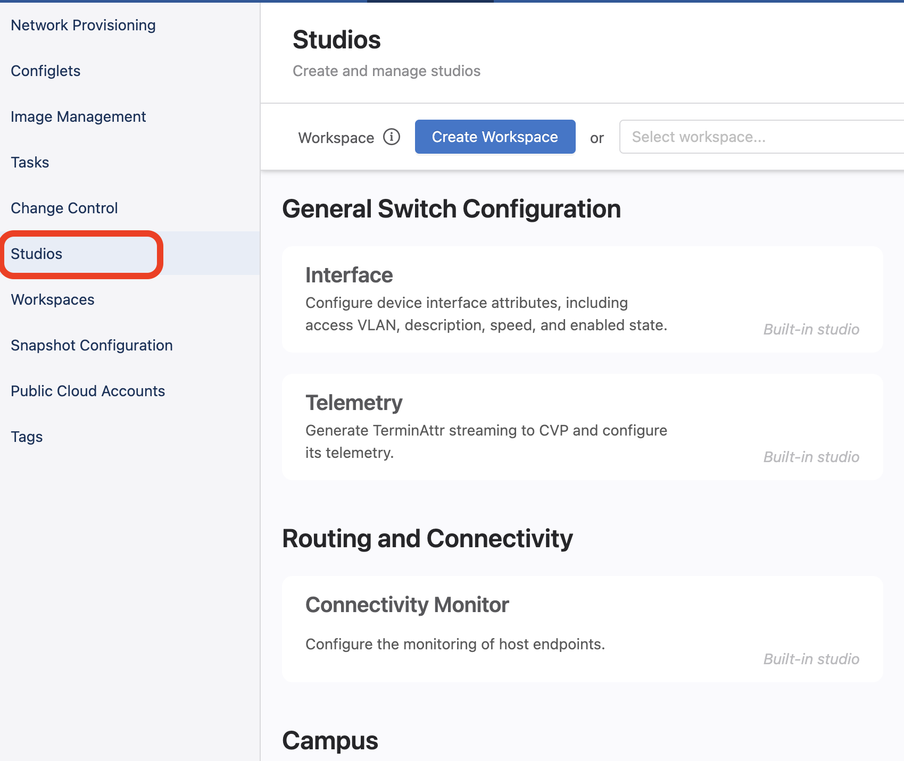
User naturally goes here first

Slide 6
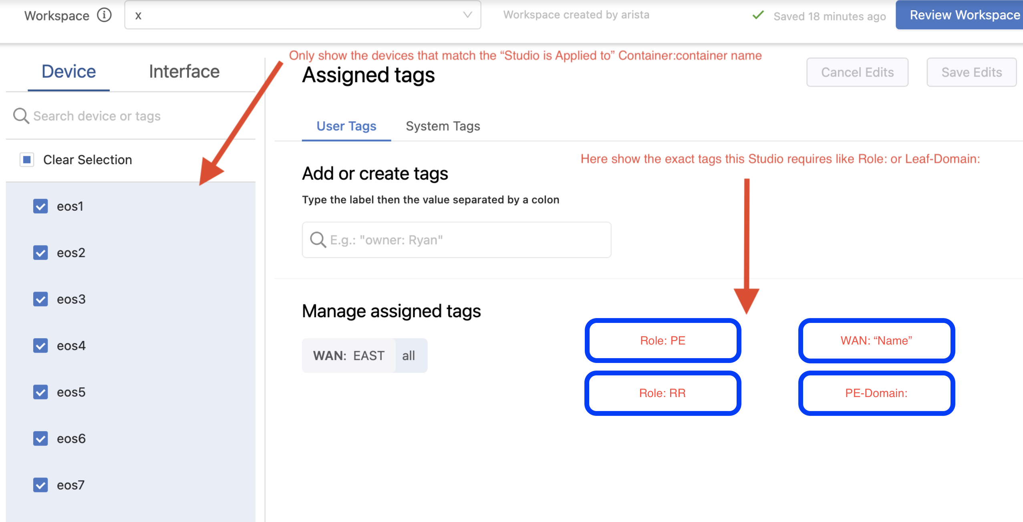
Inside the Studio edit tags or "NEXT" if tags are already set
NEXT

Slide 7
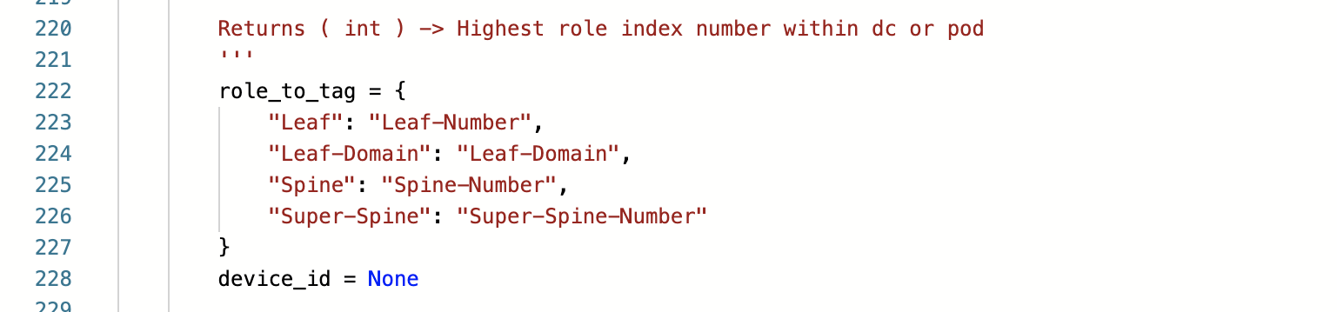
Leaf/Spine-Number tags are an issue
Else MLAG peer addresses don’t match up for example
Maintaining these tags doesn't scale well
Over time tag-numbers can become non-contiguous
Any 2 Leafs should be able to be in a Leaf-Domain regardless of their number

Slide 8
Leaf/Spine-Number tag is a burden
We are forcing a new value to track on the user
Why does the user care about a Leaf Number?
Why should a user be burdened?
Why can't this managed by the system behind the scenes?

Slide 9
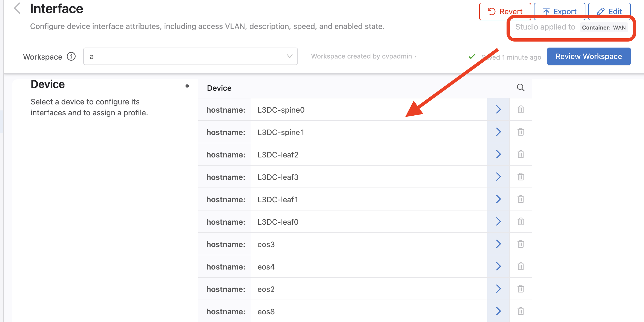
Interface Studio all devices shown but user only cares about the one's the is "Studio applied to"

Slide 10
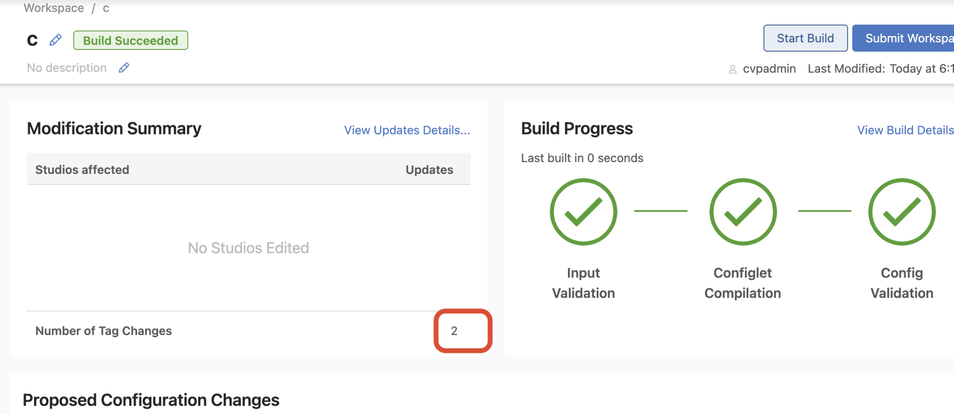
Changing a tag does not trigger a rebuild

Slide 11
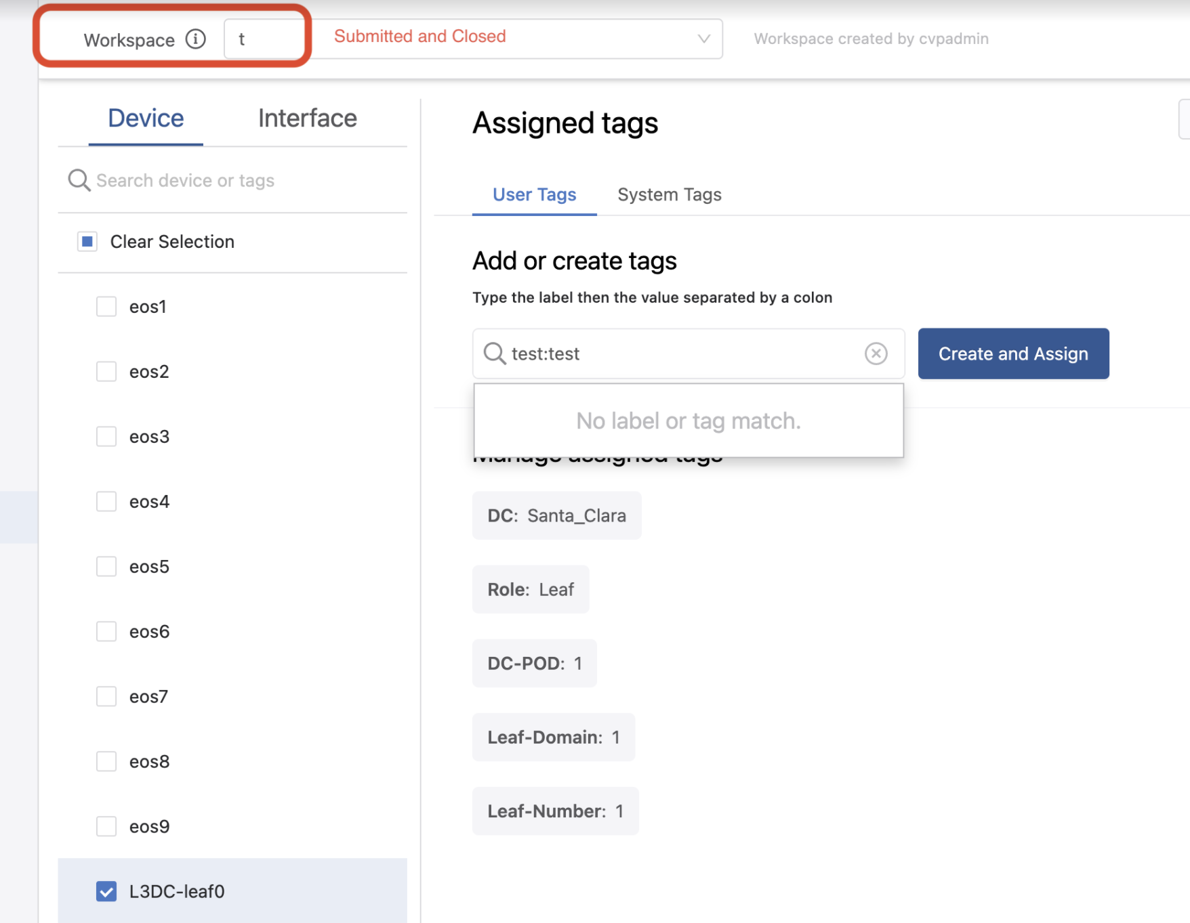
Tags can be mistakenly be edited in a closed workspace

